Slide 1
Network and semantic analysis of the dissemination of italian fact-checking on Twitter
Lorenzo Federico - LUISS
ECREA Post-Conference 24/10/2022
work in collaboration with Elena Musi, Anika Kalra and Aydan Azimova

Slide 2
Goals of the analysis and Data Collection
The goal of the project was to analyse the outreach of the content posted on Twitter by the recognized Italian fact checkers and compare it with important disinformation outlets.
We selected 5 of the 7 fact checkers recognized by the International Fact-Checking Network (the other 2 had set up their Twitter too recently) and 10 disinformation websites with similar number of followers.
We gathered 1 year of data (November 2020/October 2021) about the content they posted and all the engagement it received (likes, retweets, replies) for a total of ∼1.5 million tweets.
We will now show similarities and differences we found between the two groups.

Slide 3
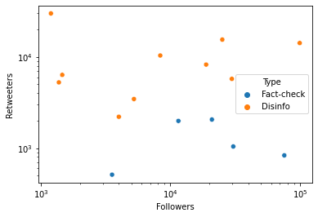
Active vs passive audience
We compared for the two groups the size of the passive audience (followers) and the active audience (retweeters)
We see that for the same number of followers, the disinformators have a significantly higher number of users that share their content

Slide 4
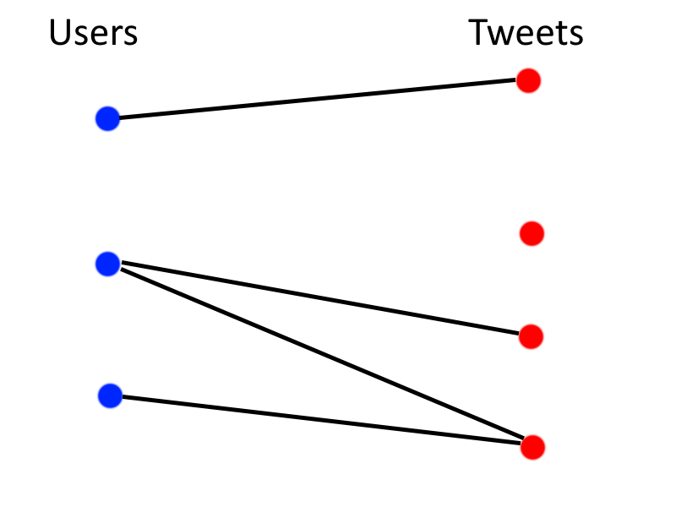
User-content networks
To study the network structure of the communication on twitter we built bipartite networks where nodes are one one side the tweets of the factcheckers and disinfluencers and on the other are the users that interact with them.
Edges represent interactions like replies and/or retweets

Slide 5
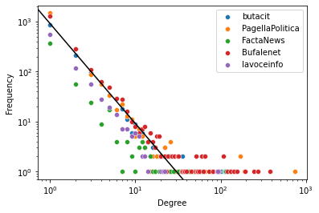
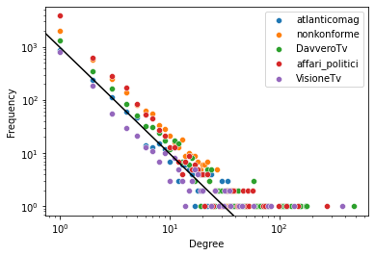
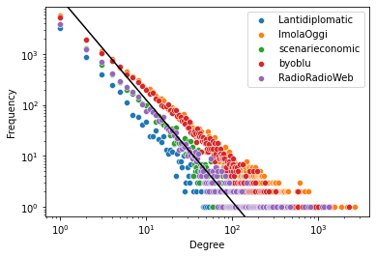
Distribution of retweet per user
Number of retweets per user during the year follow a power-law for all 15 accounts. We see that some disinfluencers have a very heavy tailed distribution (some users with extremely high amount of retweets).
This is a well known phenomenon in social media, related to what is called “preferential attachment” (popular tweets receive more exposure and thus even more engagement).

Slide 6
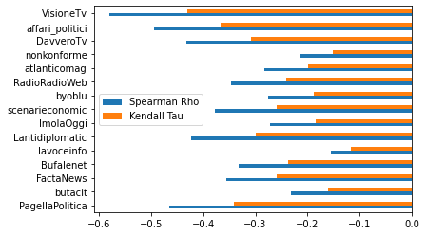
Degree-disassortativity in user-content networks
We measured the level of degree-assortativity in the networks for each account.
All these networks are degree-disassortative, that is less active users interact on average with more viral tweets.
This is a sign of what we call a core-periphery structure.

Slide 7
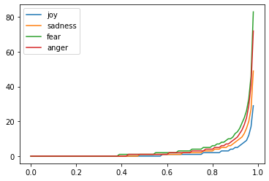
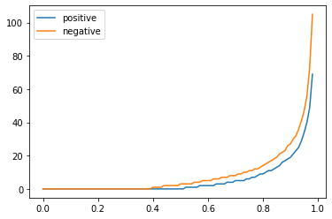
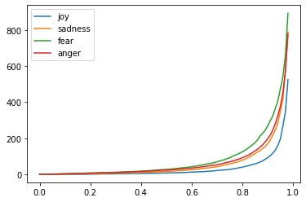
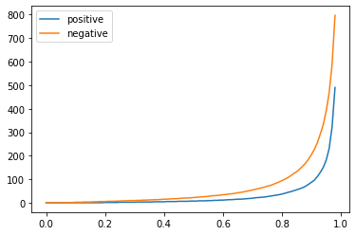
Engagement and emotion
We divided the tweets by the emotion expressed and by the prevailing positive or negative sentiment.
The graphs show the distribution of engagement for the factcheckers (above) and disinfluencers (below) by emotion and polarity.
Engagement is concentrated on few tweets, all containing negative emotions.

Slide 8
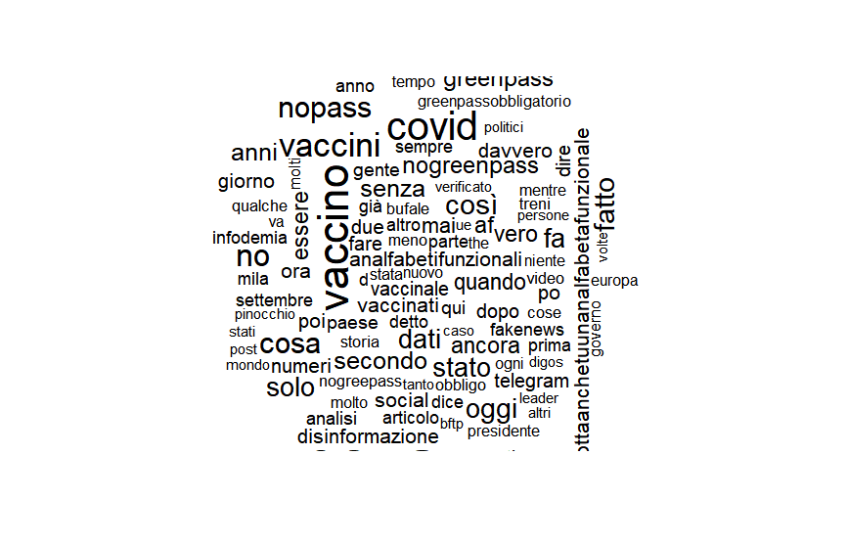
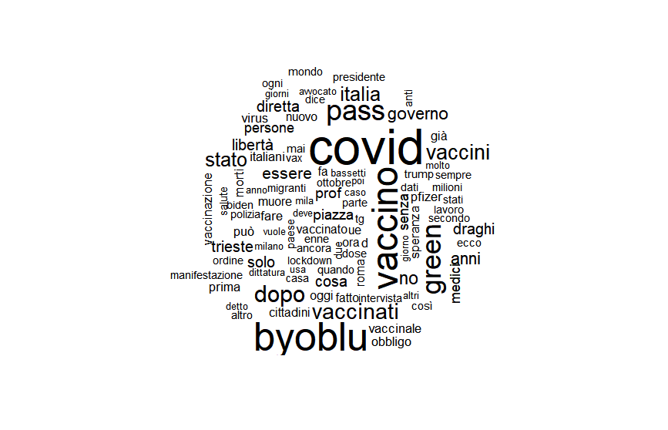
Semantic and topic analysis
We ran topic modelling on the tweets in the top 10% by engagement in both datasets. Given the timeframe of the study, the most common topics are related to the COVID 19 pandemic.
Are also very frequent self-referential expressions, while in the disinfo dataset contains a lot more names of personal names (e.g. ‘draghi’, ‘trump’, ‘biden’) of political figures as well a common name designating categories of people (e.g. ‘medici’, ‘migranti’, ‘polizia’). This is not surprising since blame culture constitutes a kernel of disinformation.

